Slide 1
Inheritance vs Composition

Slide 2
Inheritance
A process allowing for increasing specialisation of class behaviour
Enables extension of class functionality
Enables alteration of class behaviour enabling more specific functionality
Enables code reuse
Should only be used for conceptually similar classes
Should follow the Liskov Substitution Principle
It is easier to add new subclasses (inheritance) than it is to add new front-end classes (composition), because inheritance comes with polymorphism.

Slide 3
Inheritance Cons
Can confine and limit class behaviour. If classes Student and Employee both inherit from class Person it then becomes impossible to for a student to become and Employee without reinitiating the object as a new Person
Leads to close coupling leading with unexpected programme behaviour (ripple effects) when changes are made to Super classes
Can cause confusion if metaphors are improperly used. For example if you have a Dog and Cat class inheriting from a Human class behaviour becomes unpredictable and other programmers can become confused. Should a Dog class have a greet() method?

Slide 4
When to use inheritance
Both classes are in the same logical domain
The subclass is a proper subtype of the superclass
The superclass’s implementation is necessary or appropriate for the subclass
The enhancements made by the subclass are primarily additive.

Slide 5
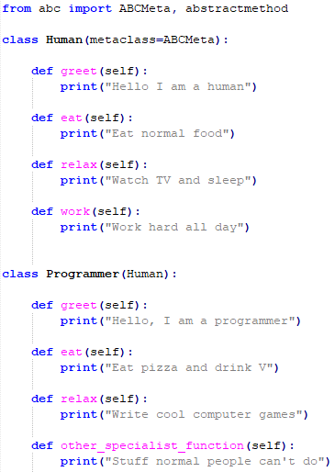
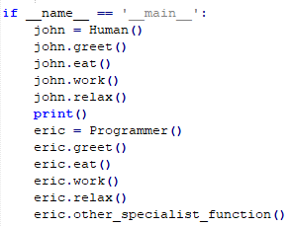
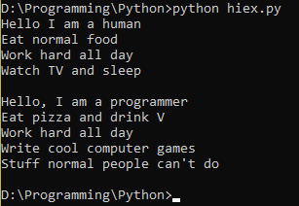
Example
Establishing basic behavior and interface using the Human class
Inheriting Human behavior
Overriding Human behaviour with Programming behaviour
Greater abstraction and simplification of code
Easier understanding and maintenance when done well

Slide 6
Composition
Uses an instance (object) of a class
Defined dynamically at run-time through objects getting references to other objects.
has-a association between objects.
Assembling/Composing objects to get more complex functionality.
BLACK-BOX REUSE: Composed objects require a well-defined interface to hide their internal details.
Doesn’t break encapsulation – objects accessed only through their interfaces.
Objects can be replaced at run-time by another – as long as it’s the same type.

Slide 7
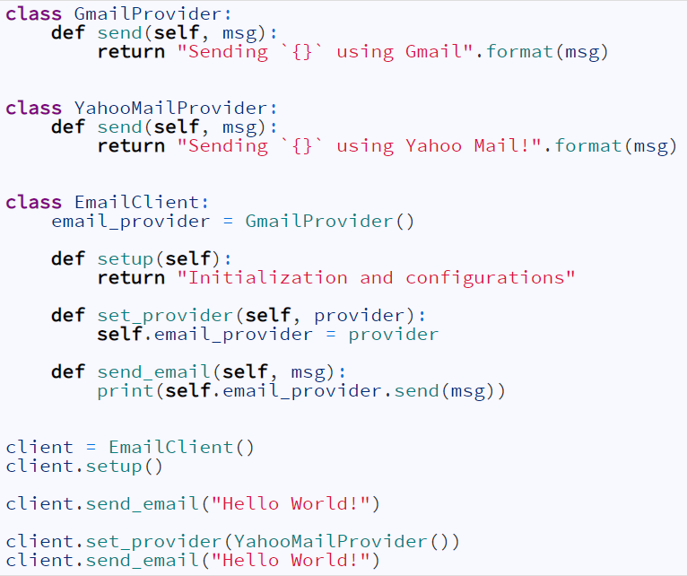
Example
Storing a type of email provider and delegating the task of sending an email to this provider.
Composing the behavior of EmailClient class by assembling objects together.
Can swap out email provider anytime by set_provider method.

Slide 8
Composition vs Inheritance
Inheritance is when you design your types around what they are
Composition is when you design your types around what they do
The easiest way to tell the difference between the two is by using the rule HAS-A and IS-A.
General rule of thumb is if IS-A makes sense you use inheritance, if HAS-A makes sense use composition.
An example: The relationship of a “car IS-A tire” doesn’t make sense, which means you cannot use inheritance but a “car HAS-A tire” makes sense so you can use composition.
A simple rule is when a subclass specifies a base class use inheritance. Use composition when you want code that is easy to change and loosely coupled.

Slide 9
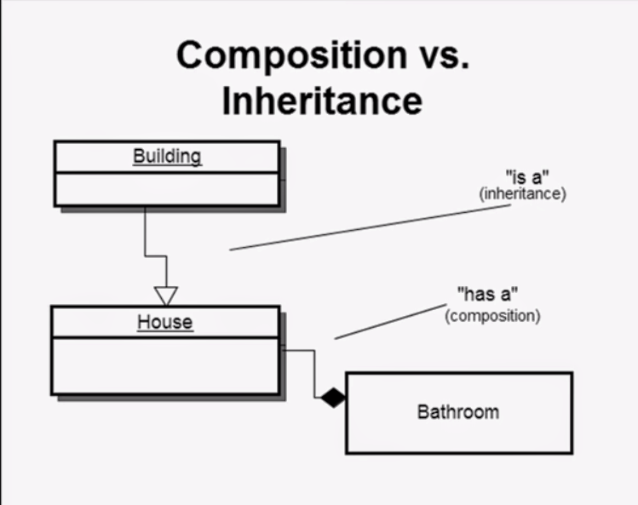
Example
An example of the IS-A and HAS-A rule in action.

